Slide 1

Real-time Imaging of Soft Tissues during
Surgery, with focus on Lumpectomy
Kathir Ilakkiyan S M
Vishal Kumar
BTP Supervisor: Dr. Kanagaraj S
Department of Mechanical Engineering
Indian Institute of Technology Guwahati
ME 499 BTP Phase IV Presentation​
27th April 2024, IIT Guwahati, Guwahati, India​

Slide 2
Contents
Introduction​
Literature Review​
Research Gaps​
Objectives​
Methodology​
Results​
Conclusion and Future Scopes​
References​

Slide 3
Introduction
Breast cancer is the most common type of cancer in women globally.
25.8% of the new cancer cases in women diagnosed in 2020.
Mastectomy, lumpectomy, radiotherapy and chemotherapy.
Invasive Ductal Carcinoma is the most common type of breast cancer.
Ductal carcinoma - starts in the milk ducts
Invasive ductal carcinoma - when it spreads to the outer tissues and lymph nodes
The healing time is much longer if patient undergoes mastectomy.
Lumpectomy is a better option regarding recovery time and preserving the original appearance.
Ultrasound (US) imaging is used for intraoperative surgical guidance.

Slide 4
Literature Review
Imaging-Assisted Endoscopic Surgery (Ukimura and Gill):
Ultrasound real-time imaging
Synchronisation of the real-time US image with higher resolution images of CT/MRI
Augmented reality (AR) was used in laparoscopic surgery
Colours were projected on tissues during laparoscopy for precision
Static images (MRI/CT) were used for guidance
No dynamic tracking feature
Medical Hyperspectral Imaging (Panasyuk et al.):
Used for removing residual cancer tissues
Spectroscopic method that generates a map of the region using biomarkers
Focussed on lumpectomy
A map of various colours to distinguish the cancer cells
Only a static spectral image to guide the surgeons

Slide 5
Literature Review
Surgical Blades in Cutting Soft Biological Tissue (Liu et al.):
Review of several cutting mechanisms
Soft tissue type, blade material, cutting parameters, and the amount of damage
Cutting methods: incising, puncturing, shearing, and shaving
Cutting phases: deformation, rupture, intermediate, and steady
Biomechanical Properties of Breast Tissue (Ramiao et al.):
Mechanical testing of ex vivo breast tissues and MR Elastography for in vivo tissues
Ex vivo tumour tissues showed 5 times elasticity of the normal fat tissue and glandular tissue
MR Elastography showed 1.5-2 times elasticity for in vivo tumour tissues
Tumour tissues were harder and stiffer than the healthy normal tissues

Slide 6
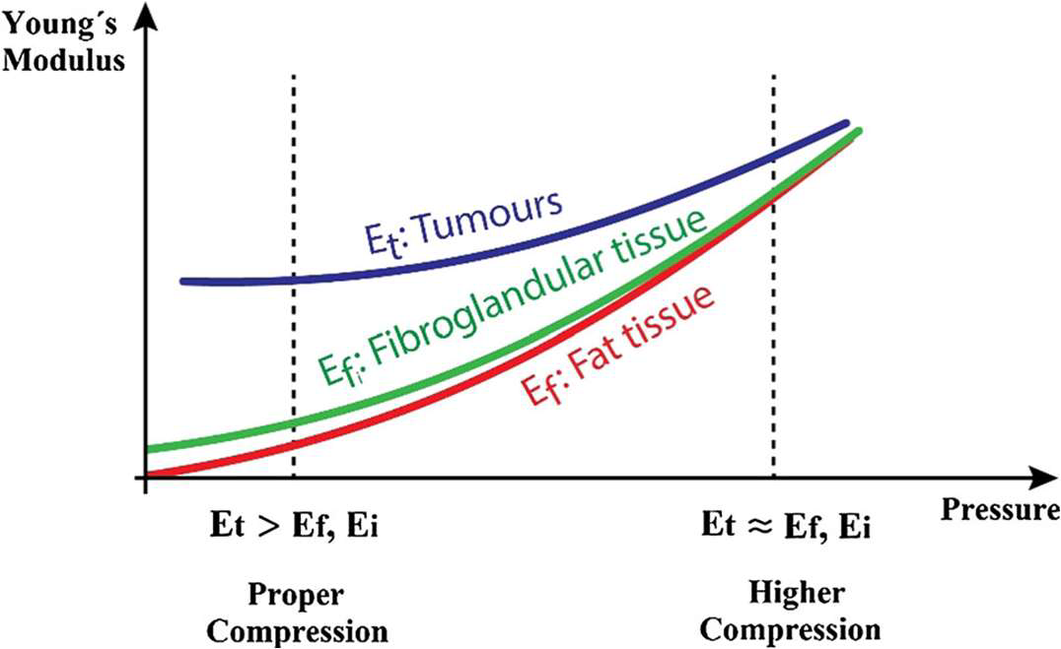
Image from ‘Biomechanical properties of breast tissue (Ramiao et al.)’

Slide 7
Literature Review
Piezo-driven Microinjection System with Force Feedback (Wang and Xu):
Microinjection system driven by piezoelectric actuators
Strain gauge and piezoelectric actuators put together to transfer electrical signal into movement
Force sensor on the cells to measure the indentation force
Controlled and linear motion of the injector, unlike hand operation
Force Feedback in Robot-assisted Minimally Invasive Surgery (Kun et al.):
Resistance-based miniature force sensor
Flexible structure generates the strain
Strain gauge attached record the resistance variance and voltage changes
Voltage variance is calibrated to give the force feedback

Slide 8
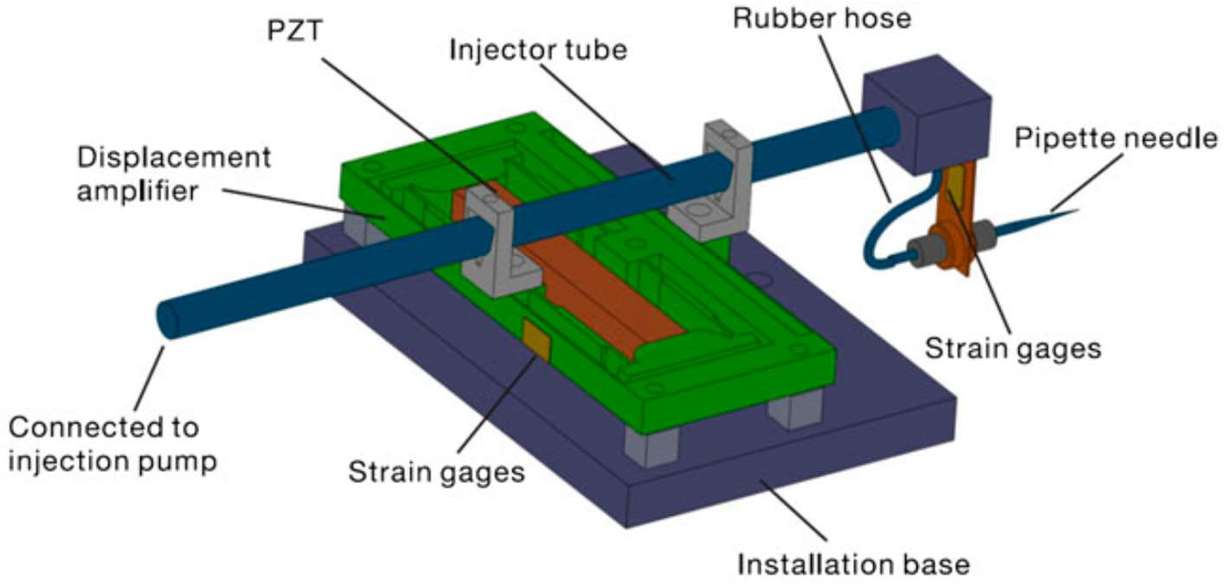
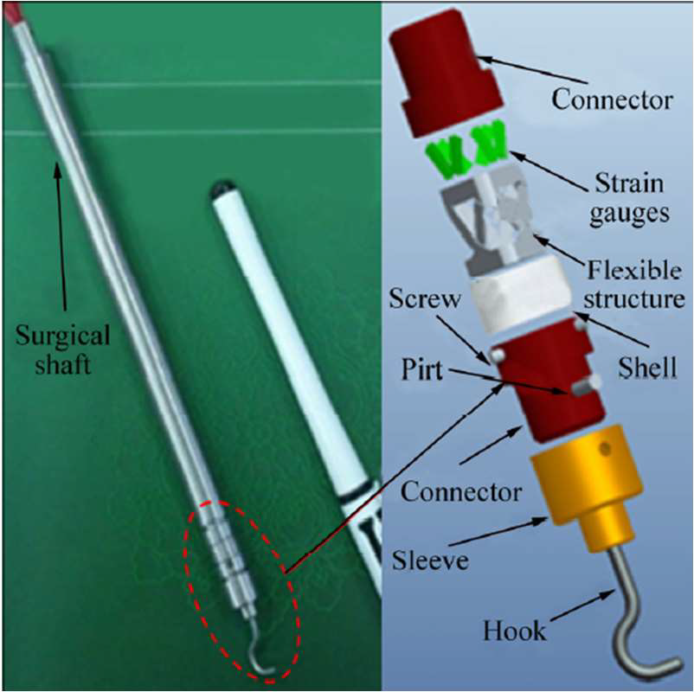
Image from ‘Piezo-driven microinjection system (Wang, Xu)’
Image from ‘Force feedback in robot-assisted minimally invasive surgery (Kun et al.)’

Slide 9
Literature Review
A Single Camera Tracking System for 3D Position (Shin et al.):
3D position-tracking system for the laparoscopic surgical tool
Five optical reflective markers placed collinearly at tip
The probe had four spherical reflective markers
High-level tracking algorithm was used to extract tool positions
Calibration of Tip Position with Marker-Based Tracking (Koeda et al.):
Developed a liver surgery tracking system for the surgical tool
Deformation of the liver was tracked too
Special markers were set on top of the knife
Error between the markers and the estimated knife-tip position was 0.3 mm

Slide 10
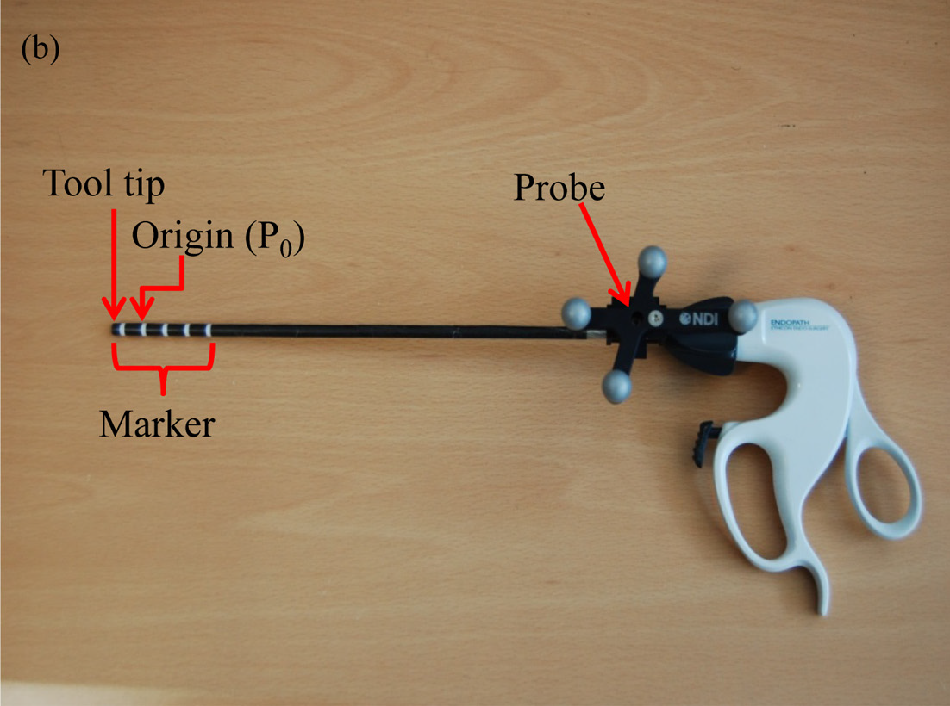
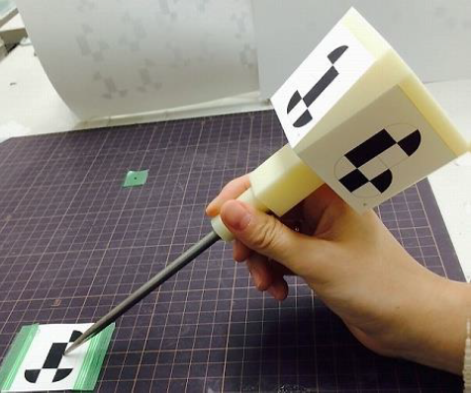
Image from ‘A Single Camera Tracking System (Shin et al.)’
Image from ‘Calibration of Tip Position with Marker-Based Tracking (Koeda et al.)’

Slide 11
Research Gaps
No real-time visualization of dynamic movement of internal tissues during surgery
Proper tracking algorithm should be developed and implemented for the intraoperative movements to be tracked
Force feedback is not associated with lumpectomy surgery
Better depth estimation of the tumour and could help in positioning of the tool

Slide 12
Objectives
The main objective of this project is to make the surgical process more efficient by minimizing the healthy tissues removed along with malignant tissues during surgery while maintaining a certain safe margin around them.
To detect the depth of the tumour tissue from the breast skin.
To track the surgical tool during the surgery process.
To make it easier to minimize the amount of healthy tissues removed around the tumour tissues.

Slide 13
Methodology
Segmentation
Zone-Defining
Force Feedback
Silicone Phantom
Surgical Tool Tip Tracking
Tracking Integrated with Force Feedback

Slide 14
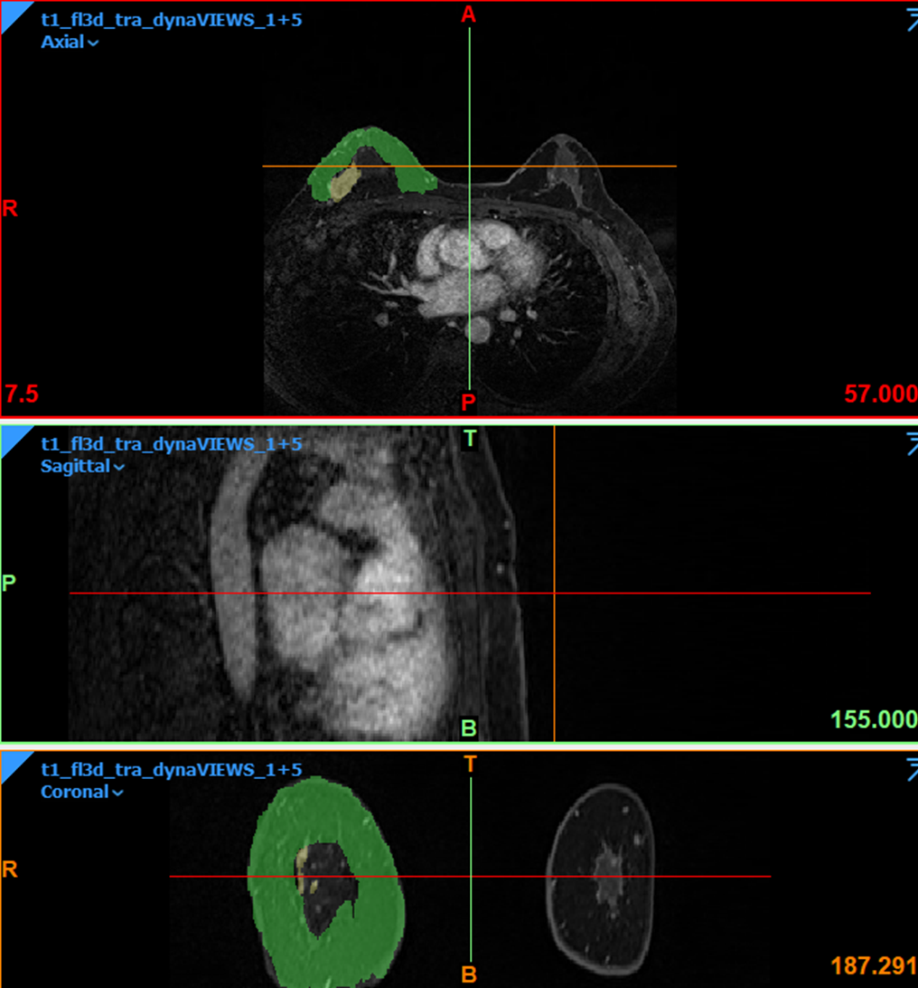
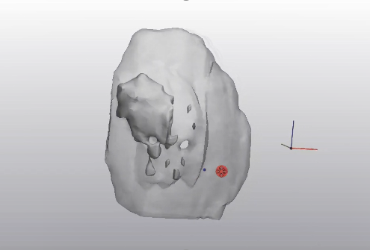
Segmentation
Cancer tissues in the upper outer quadrant of the right breast with satellite nodules
Segmentation of breast tissues from MRI (Patient 1) using Materialise Mimics software

Slide 15
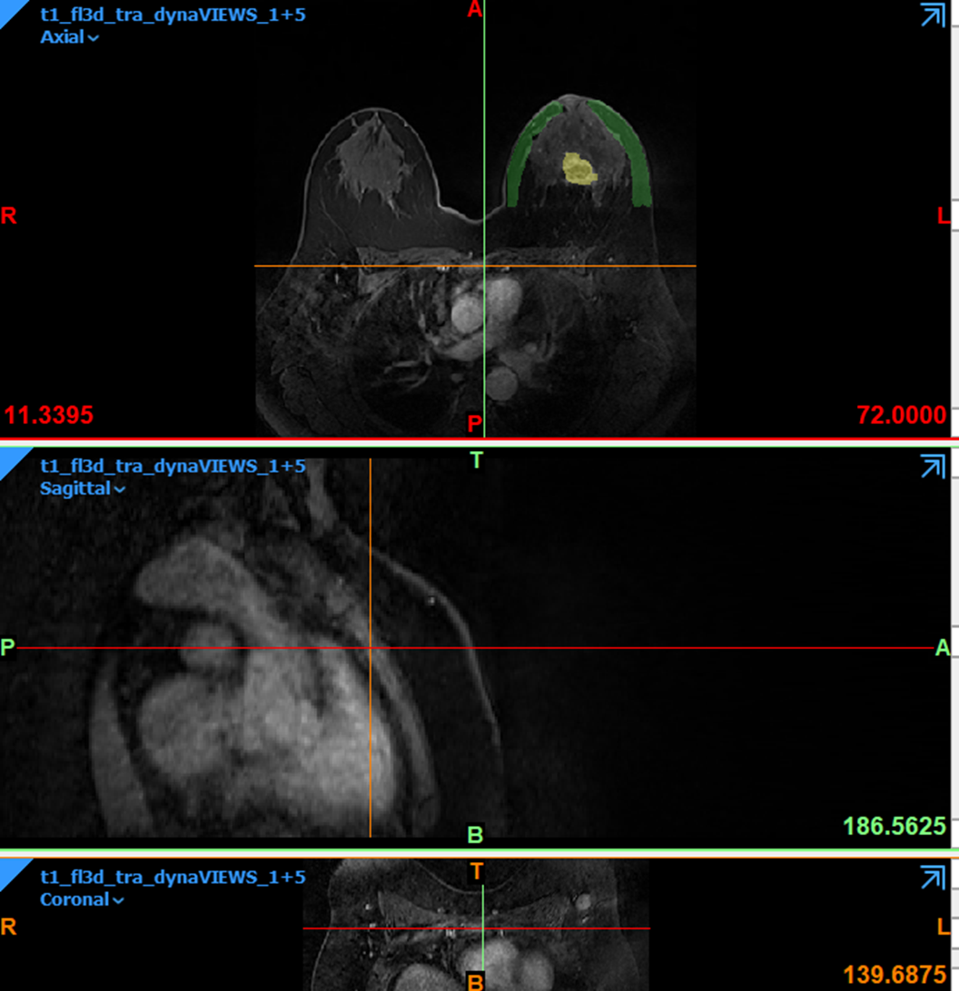
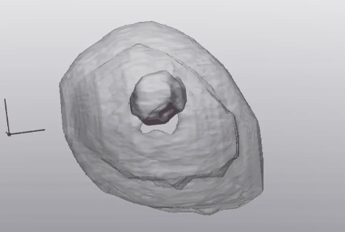
Segmentation
Malignant mass in the retroareolar region of the left breast
Segmentation of breast tissues from MRI (Patient 2) using Materialise Mimics software

Slide 16
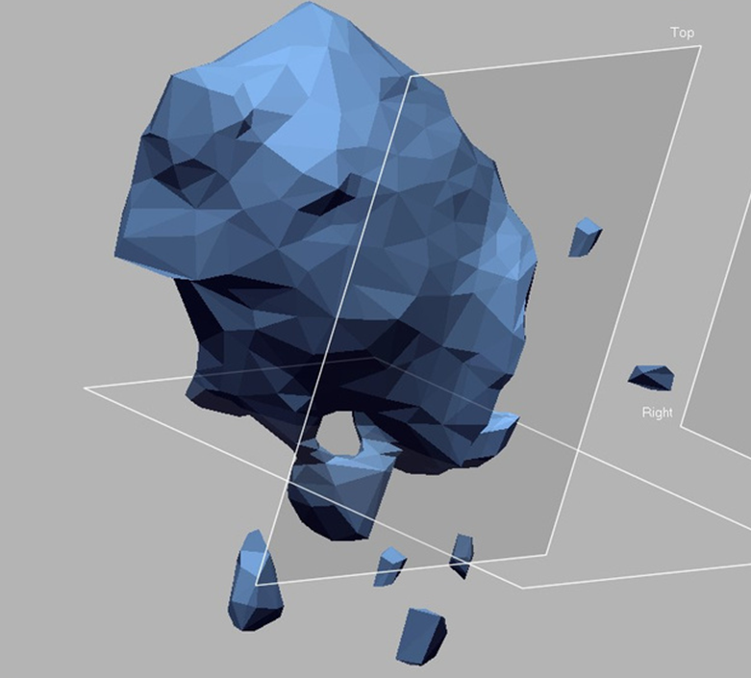
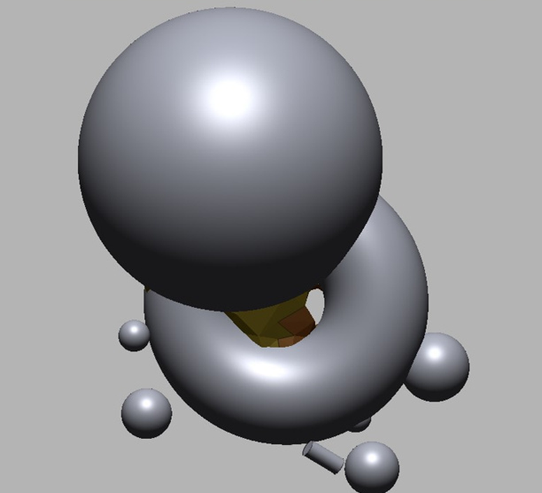
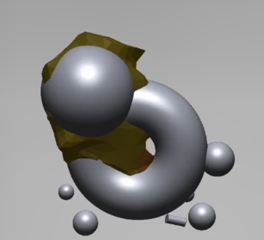
Zone-Defining
Zone defining and modification with primitive shapes using Geomagic design X software

Slide 17
Force Feedback
Cancerous tissues have higher stiffness compared to the normal healthy tissues.
Tumour is stiffer - the resistance force could be higher during incision
Can be used to estimate the depth of the tumour
As breast tissues are soft, tumour position could be continuously varying.
Depth estimation using force could be irrespective of the position of the tissues.

Slide 18
Force Feedback
A Force sensor setup was made using the Tinkercad online circuit design platform
An actual circuit was further made to use the setup physically.
A Force Sensing Resistor (FSR) was used to measure the force.
FSR range: 100 g to 20 kg
Capacitor was used to stabilize the force readings

Slide 19
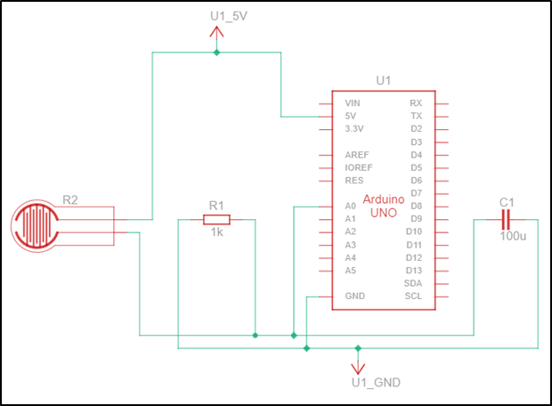
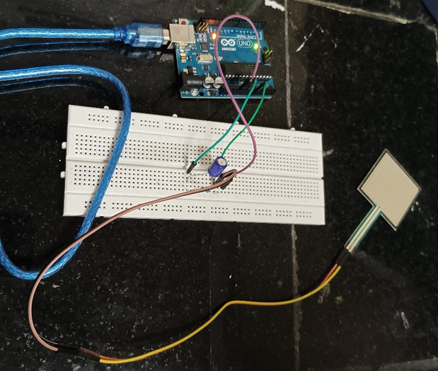
Tinkercad Circuit
Actual Circuit

Slide 20
Force Feedback
float cf = 0.314; //Calibration factor (0.314)
int Reading=0;
float vout;
void setup() {
Serial.begin(9600);
}
void loop() {
Reading = analogRead(A0);
vout = (Reading*5.0)/1023.0;
vout = vout*cf;
Serial.print("Force Sensor Reading = ");
Serial.print(vout,3);
Serial.print(" kg, ");
Serial.print(vout*9.81,3);
Serial.print(" N, calibration factor = ");
Serial.print(cf,3);
Serial.println("");
delay(500);
}
Calibration factor of 0.314 has been calculated for the FSR using multiple known weights

Slide 21
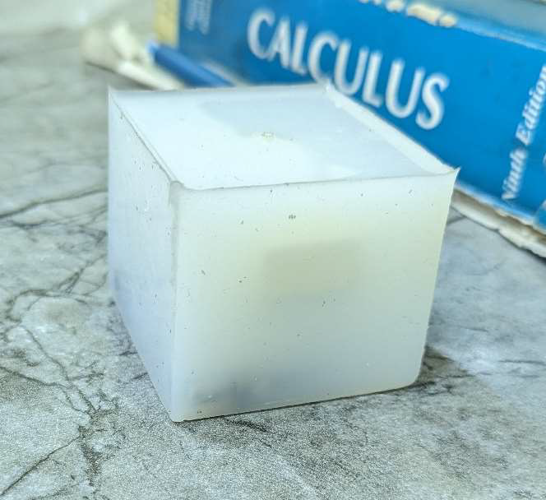
Silicone Phantom
A silicone phantom was used to mimic the breast and tumour tissues.
Materials used,
Breast tissue: Silicone LSR Grade 120 (TS: around 0.95 MPa)
Tumour tissue: Rubber (stiffer material than silicone)
A cubic mold was used to create the silicone casting.
A rubber piece was completely immersed into the liquid silicone.
The dimensions of the silicone cube: 50mm x 50mm x 40mm
The dimensions of the rubber piece: 30mm x 20mm x 10mm.

Slide 22
Surgical Tool Tip Tracking
Tracking the tool can make the surgery more efficient.
A scalpel has been used as a basic surgical tool.
A CAD model was designed to be 3D printed and fixed on the scalpel.
3 optical reflective markers can be placed on the model.
A mathematical relation has been devised to estimate the tip coordinates.

Slide 23
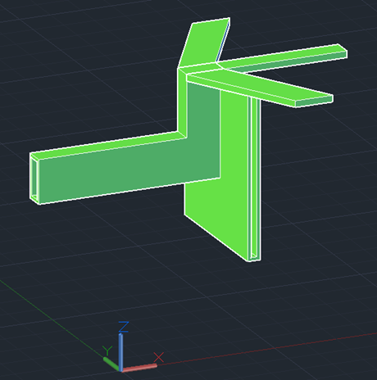
Surgical Tool Tip Tracking
CAD model of the tracker that could be inserted on the tool head

Slide 24
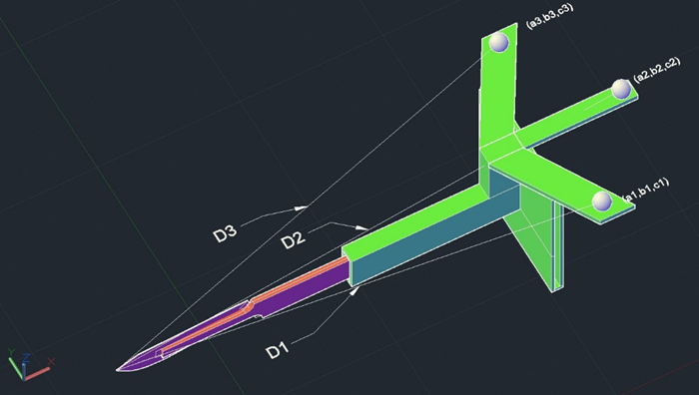
Surgical Tool Tip Tracking
The coordinates of the reflective markers can be calibrated and tracked continuously.
The distances to the tip are fixed unless a marker is replaced.

Slide 25
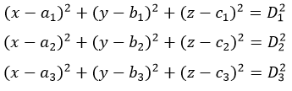
Surgical Tool Tip Tracking

Slide 26
Surgical Tool Tip Tracking
q = points - points(3,:);
e = null(q)'*sqrt(norm(q(1,:))*norm(q(2,:)));%vector normal to plane
trans = (1/3)*sum(points) + e;
p_translated = points - trans; % translate
w = sum(p_translated.*p_translated,2)-distance.^2;
q1 = p_translated\ones(3,1);
qw = p_translated\w;
A = roots([q1'*q1, (2*qw'*q1-4), qw'*qw]); % A = snew dot snew
snew = (1/2)*(q1*A.' +qw)'; % one row of (x,y,z)
tip_coordinates = snew + trans;
MATLAB code was made to compute the tool tip coordinates
With known marker coordinates and distances to the tip, tip coordinates can be calculated.

Slide 27
Tracking Integrated with Force Feedback
The tool tip tracking can be integrated with the force feedback system.
A slit gap is provided in the tracker model to place the FSR.
Resistive force on the scalpel could be directly transmitted to the FSR.
User’s interference with the force readings could be minimized.
The tool head can touch the FSR directly through the hole.

Slide 28
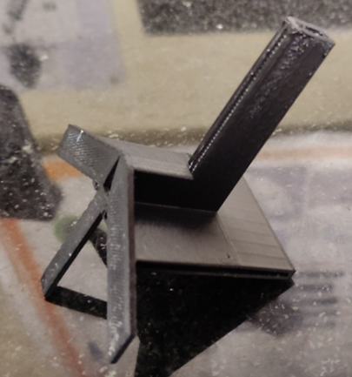
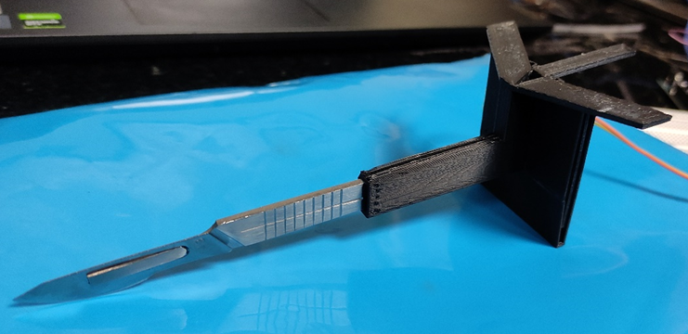
Tracker Model with a slit gap for FSR

Slide 29
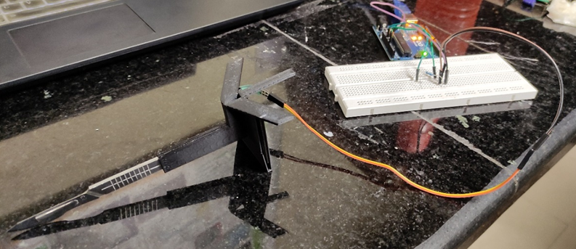
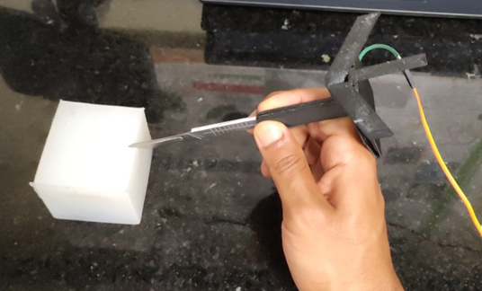
Complete Setup
During Operation

Slide 30
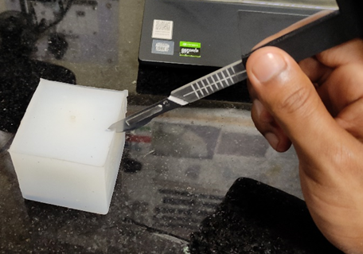
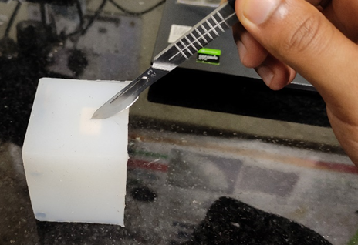
Tracking Integrated with Force Feedback
(a)
(b)
Force feedback readings were taken while operating the scalpel.
Incision was made away and far from the rubber piece - (a)
Incision was made towards and close to the rubber piece - (b)

Slide 31
Results
The MR images were successfully segmented and 3D models of breast tissues were obtained.
Zone-defining has been performed.
MATLAB code was run with a set of positions of the markers and distances to the tooltip.
points = [109.32 26.72 67.71;
134.07 59.70 67.71;
109.32 92.68 67.71];
distance = [157.70 178.75 157.70]';
OUTPUT:
tip_coordinates =
-43.3546 59.7000 45.9824
-43.3546 59.7000 89.4376

Slide 32
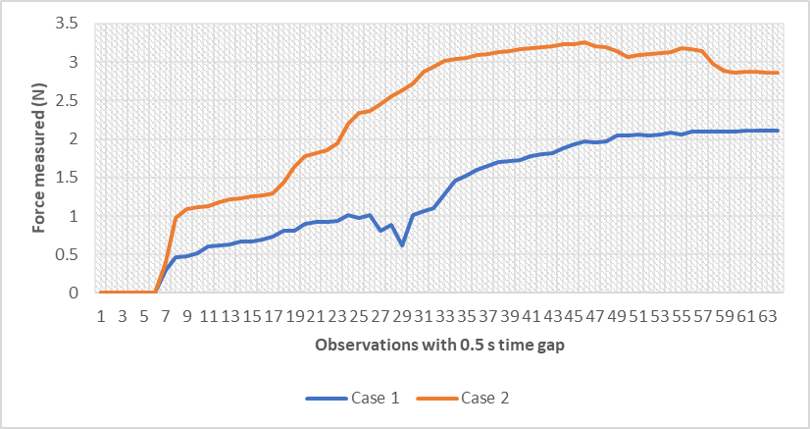
Results
FSR sensor was placed in the slit and integrated successfully with the tracking system.
Graph comparing force feedback for the two incision cases

Slide 33
Results
The readings clearly display higher force feedback when cut was made at towards the rubber piece.
The stiffness difference could be measured using a FSR successfully
Also proves the working of the ‘Tracking + Force feedback’ setup designed.
Force Sensor Reading = 0.000 kg, 0.000 N
Force Sensor Reading = 0.031 kg, 0.301 N
Force Sensor Reading = 0.048 kg, 0.467 N
Force Sensor Reading = 0.049 kg, 0.482 N
Force Sensor Reading = 0.052 kg, 0.512 N
Force Sensor Reading = 0.061 kg, 0.602 N
Force Sensor Reading = 0.063 kg, 0.617 N
Force Sensor Reading = 0.064 kg, 0.632 N
Force Sensor Reading = 0.068 kg, 0.662 N
Force Sensor Reading = 0.000 kg, 0.000 N
Force Sensor Reading = 0.041 kg, 0.406 N
Force Sensor Reading = 0.100 kg, 0.979 N
Force Sensor Reading = 0.110 kg, 1.084 N
Force Sensor Reading = 0.114 kg, 1.114 N
Force Sensor Reading = 0.115 kg, 1.129 N
Force Sensor Reading = 0.120 kg, 1.174 N
Force Sensor Reading = 0.124 kg, 1.219 N
Force Sensor Reading = 0.126 kg, 1.235 N
Example Readings for both incision cases

Slide 34
Conclusions
3D modelling of MR images could immensely aid with the visualization of the tissues.
Zone-defining process could help the surgeon to plan the shape of the cut and modify easily.
3D tool tracking can greatly improve the accuracy and the confidence of the surgeon.
The stiffer the material, the higher the force feedback.
Force feedback could aid in depth estimation.
FSR fixed behind the tool could provide quite accurate readings.

Slide 35
Future Scopes
3D model segmented can be registered in the trackable 3D space.
Better shapes can be used to accurately zone-define.
A tracking algorithm can be made to incorporate the mathematical relations formed.
Smaller FSR and setup can be developed to make it more comfortable for the surgeon.

Slide 36
Łukasiewicz, S., Czeczelewski, M., Forma, A., Baj, J., Sitarz, R., & Stanisławek, A. (2021). Breast Cancer-Epidemiology, Risk Factors, Classification, Prognostic Markers, and Current Treatment Strategies-An Updated Review. Cancers, 13(17), 4287.
Scholl, A. R., & Flanagan, M. B. (2020). Educational Case: Invasive Ductal Carcinoma of the Breast. Academic pathology, 7, 2374289519897390. https://doi.org/10.1177/2374289519897390
Ukimura, O., & Gill, I. S. (2008). Imaging-assisted endoscopic surgery: Cleveland Clinic experience. Journal of endourology, 22(4), 803-810.
Panasyuk, S. V., Yang, S., Faller, D. V., Ngo, D., Lew, R. A., Freeman, J. E., & Rogers, A. E. (2007). Medical hyperspectral imaging to facilitate residual tumor identification during surgery. Cancer biology & therapy, 6(3), 439-446.
Ramiao, N. G., Martins, P. S., Rynkevic, R., Fernandes, A. A., Barroso, M., & Santos, D. C. (2016). Biomechanical properties of breast tissue, a state-of-the-art review. Biomechanics and modeling in mechanobiology, 15, 1307-1323.
Wang, G., & Xu, Q. (2017). Design and development of a piezo-driven microinjection system with force feedback. Advanced Robotics, 31(23-24), 1349-1359.
Li, K., Pan, B., Gao, W. P., Feng, H. B., Fu, Y. L., & Wang, S. G. (2015). Miniature 6-axis force/torque sensor for force feedback in robot-assisted minimally invasive surgery. Journal of Central South University, 22(12), 4566-4577.
Liu, Z., Wang, C., Chen, Z., Sui, J.: The advance of surgical blades in cutting soft biological tissue: a review.
Shin, S., Kim, Y., Cho, H., Lee, D., Park, S., Kim, G.J., Kim, L.: A single camera tracking system for 3D position, grasper angle, and rolling angle of laparoscopic instruments. International Journal of Precision Engineering and Manufacturing. 15, 2155–2160 (2014). https://doi.org/10.1007/s12541-014-0576-6
Koeda, M., Yano, D., Doi, M., Onishi, K., Noborio, H.: Calibration of Surgical Knife-Tip Position with Marker-Based Optical Tracking Camera and Precise Evaluation of Its Measurement Accuracy. Journal of Bioinformatics and Neuroscience (JBINS). 4, 155–159 (2018)
Adriano (https://math.stackexchange.com/users/76987/adriano), Finding the 3D coordinates of an unknown point from three known points, URL (version: 2013-05-14): https://math.stackexchange.com/q/391116
References

